Slide 1
Spatial Analysis & Interactive Visualization
for BARMM
Aldrin Lambon

Slide 2
A Thought Experiment
Brgy Report #1
Provincial Report #1
Brgy Report #2
Provincial Report #2
Brgy Report #3
One
Policy Maker
Provincial Report #3
...
Provincial Report #4
Brgy Report #2721
Provincial Report #5
Brgy Report #2722
Let’s assume that all the reports can be available in 1 year, then let’s say a policy maker needs another 6 months to consolidate everything before making a decision
This is a long and slow process...

Slide 3
Problem Statement
“Managing these political, spatial, and fiscal changes as the Bangsamoro Transition Authority (BTA) prepares the building-blocks for the Bangsamoro Parliament in 2022 will be challenging, to say the least, given competing parallel priorities affecting the roughly 4.64 million residents of the area. All of these will require thousands of simultaneous micro-decisions to be made at the same time, as well as the evidence required to make these decisions.”
Excerpt from Open Data for the Bangsamoro Transition Practical notes on using geospatial and statistical data for decision-making

Slide 4



Solution Overview
Database Architecture
Interactive Dashboard
Recommender System
Doing all of this needs a complete data science team from data engineers to domain experts. As a Proof of Concept (POC), I will be presenting to you a part of this solution, an Interactive Dashboard that utilizes both spatial and tabular data

Slide 5
Objective
To identify population hot spots and cold spots in the Bangsamoro Autonomous Region Provinces and Barangays
To utilized both tabular and spatial data into an interactive dashboard to maximize insight and functionality for policy makers
To provide an overview of the features that can be related to sustainable development goals (SDGs)

Slide 6
Data Coverage
Spatial Data:
Administrative Boundaries ARMM Barangays (PSA, 2016), Administrative Boundaries ARMM Provinces (PSA, 2016)
Tabular Data:
Population, Number of Schools, Water Supply, Fuel for Lighting, Worker Occupation and Construction Material
Source: https://www.openbangsamoro.com/

Slide 7




Methodology
Python
Spatial Data
Data Preparation
Spatial Analysis
Data Analysis
Tabular Data

Slide 8
Spatial Analysis
Univariate Spatial Clustering of Population Totals at the Brgy Level
Spatial Weights
Spatial Statistics
Spatial Clusters
Queen-based Contiguity
All barangays that share the same borders are considered neighbors
Moran’s I
measures spatial autocorrelation based on both feature locations and feature values simultaneously
Local Indicators of Spatial Association (LISA)
can identify spatial dependency ( hot spots, cold spots, and spatial outliers) in a given locality
Appendix

Slide 9
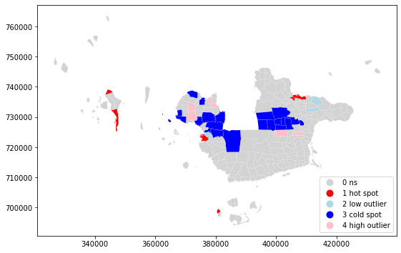
Basilan: Spatial Clusters
Cluster | # Brgys
Hotspot | 13
Coldspot | 21
High Outlier | 5
Low Outlier | 4

Slide 10
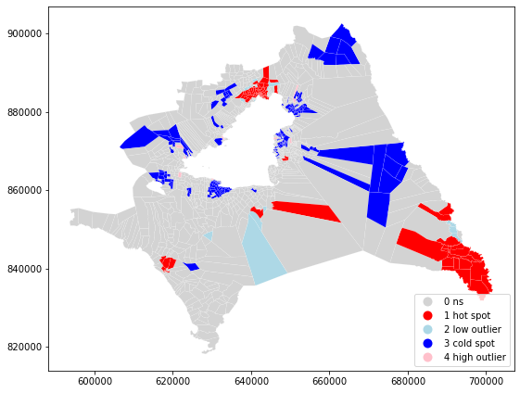
Lanao Del Sur: Spatial Clusters
Cluster | # Brgys
Hotspot | 93
Coldspot | 182
High Outlier | 8
Low Outlier | 16

Slide 11
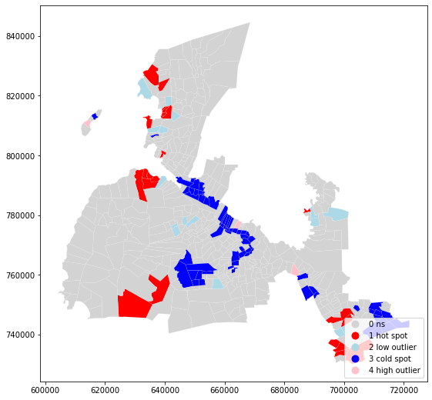
Maguindanao: Spatial Clusters
Cluster | # Brgys
Hotspot | 25
Coldspot | 69
High Outlier | 3
Low Outlier | 17

Slide 12
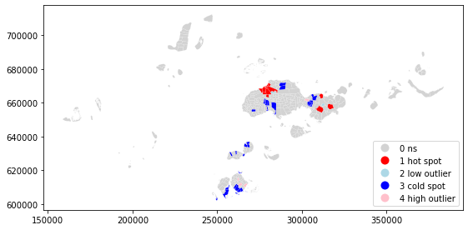
Sulu: Spatial Clusters
Cluster | # Brgys
Hotspot | 18
Coldspot | 43
High Outlier | 5
Low Outlier | 2

Slide 13
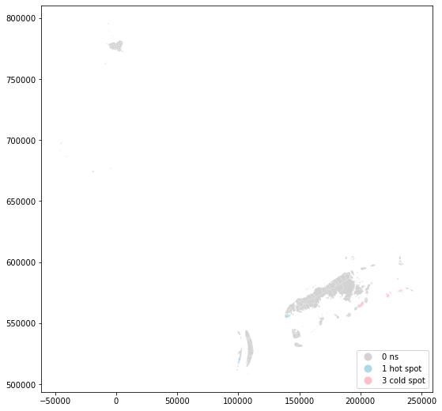
Basilan: Spatial Clusters
Cluster | # Brgys
Hotspot | 12
Coldspot | 28
High Outlier | 0
Low Outlier | 0

Slide 14
Interactive Visualization
DEMO
https://tabsoft.co/2FnC5Wn

Slide 15
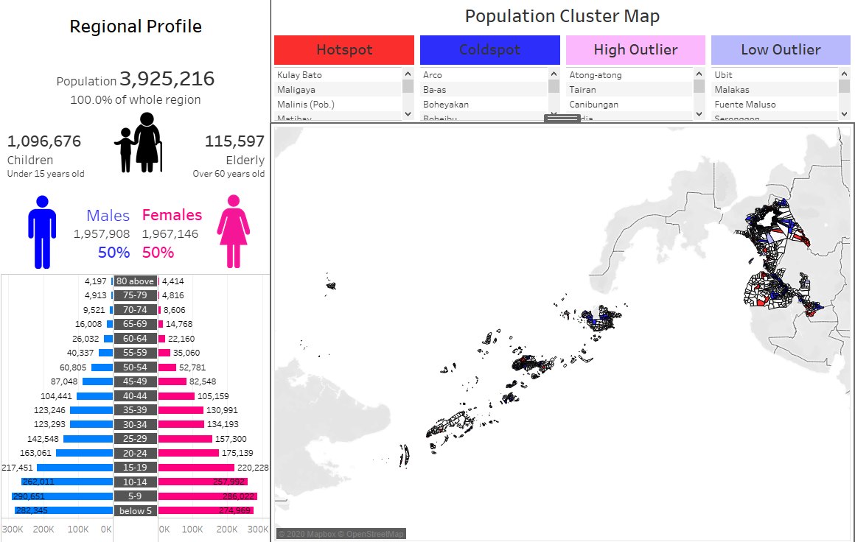
Contains Population Structure along with the Population Cluster Map

Slide 16
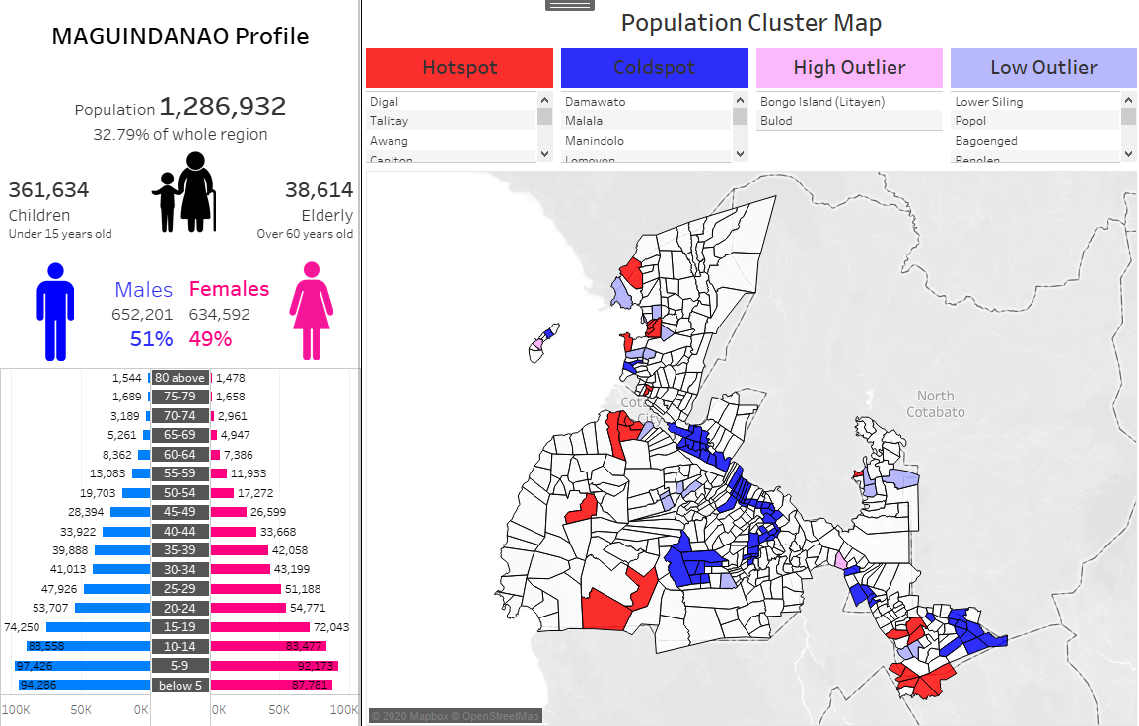
You can filter to a specific province

Slide 17
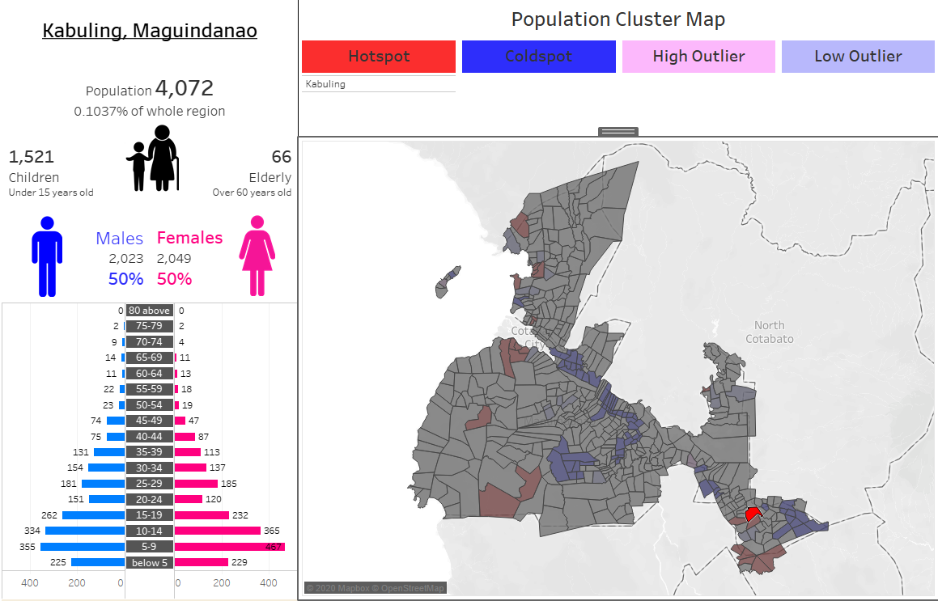
You can filter also filter to a specific barangay

Slide 18
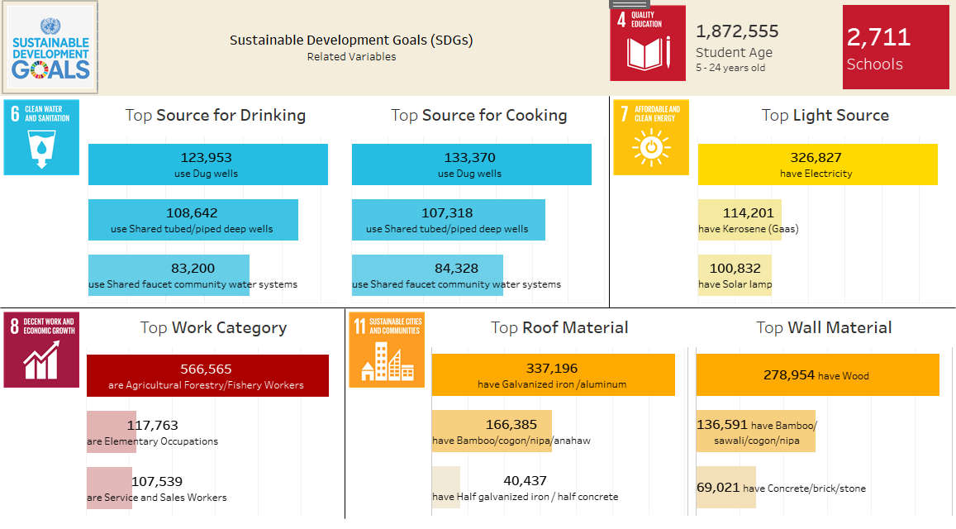
Along with the provincial and barangay filter, you can also see below the dashboard SDGs related variables the a selected location

Slide 19
Conclusion
Doing spatial analysis on the population data will aid policy makers identify areas that should be priority zones for new policies or projects
Integrating the results of spatial analysis to an interactive tableau dashboard, the policy maker can explore multiple data sources in a digestible and flexible manner. From viewing at the regional to filtering down to the barangay level
Due to the nature of the visualization software used, the policy maker can even add new data sources and add new charts to further improve the analysis

Slide 20
Moving Forward
Database Architecture
It is essential to have the right database architecture in place for faster access of data and the ability to expand to other data related projects.
An application can also be develop to upload data directly to the database, this means that policy makers can easily get .
Needed Collaboration:
Data Engineers
Software Engineers

Slide 21
Moving Forward
Recommender System
Policy makers can speed up their decision making process by utilizing a recommender system that can analyze previously implemented policies and correlate it to the characteristics of a specific location
Needed Collaboration:
Data Scientist
Policy Makers (Domain Experts)

Slide 22
Spatial Analysis & Interactive Visualization Project
Aldrin Lambon

Slide 23

Appendix: Global Moran's I
https://pro.arcgis.com/en/pro-app/tool-reference/spatial-statistics/h-how-spatial-autocorrelation-moran-s-i-spatial-st.htm

Slide 24
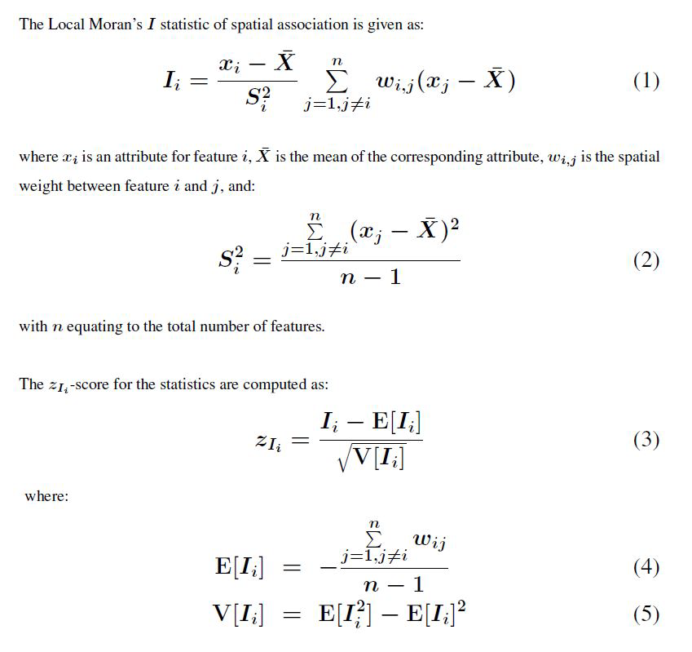
Appendix: Local Moran's I
https://pro.arcgis.com/en/pro-app/tool-reference/spatial-statistics/h-how-cluster-and-outlier-analysis-anselin-local-m.htm

